Slide 1

CS573 Data Visualization Final Project -- Public Safety: 911-Calls
Authors: Qianyun yang
Qiuzhe Ma

Slide 2
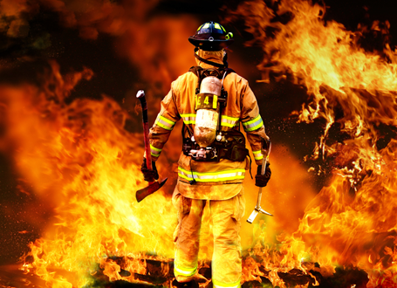
Project Motivation and Objectives
Background and Motivation
Project Objectives

Slide 3
Background and Motivation
Fire emergency happened in Seattle from 2012 to 2015.
Each year people die or are seriously injured, damage of property, loss of
business
Many of these fires can be avoided by taking fire precautions.
Our analysis may provide valuable information to improve allocation of fire
resources, and remind people about the fire prevention in effective ways.
Notes:
Our final project is about fire emergency happened in Seattle from 2012 to 2015. The existence of fire changes our life and behavior. We need fire to cook, to keep warm and fire is also necessary in manufacture. But if people are not cautious about fire, it may lead to disasters. Each year people die or are seriously injured as a result of fires at work. Besides loss of life, fire costs people millions of money from damage of property, loss of business, fire compensation and insurance premiums. Many of these fires can be avoided by taking fire precautions. If a fire breaks out a lot of the effects can be minimized by having effective controls and procedures in place. This project therefore intends to make an assessment of the factors influencing fire disaster preparedness. We consider that our analysis may provide valuable information to improve allocation of fire resources, and remind people about the fire prevention in effective ways.

Slide 4
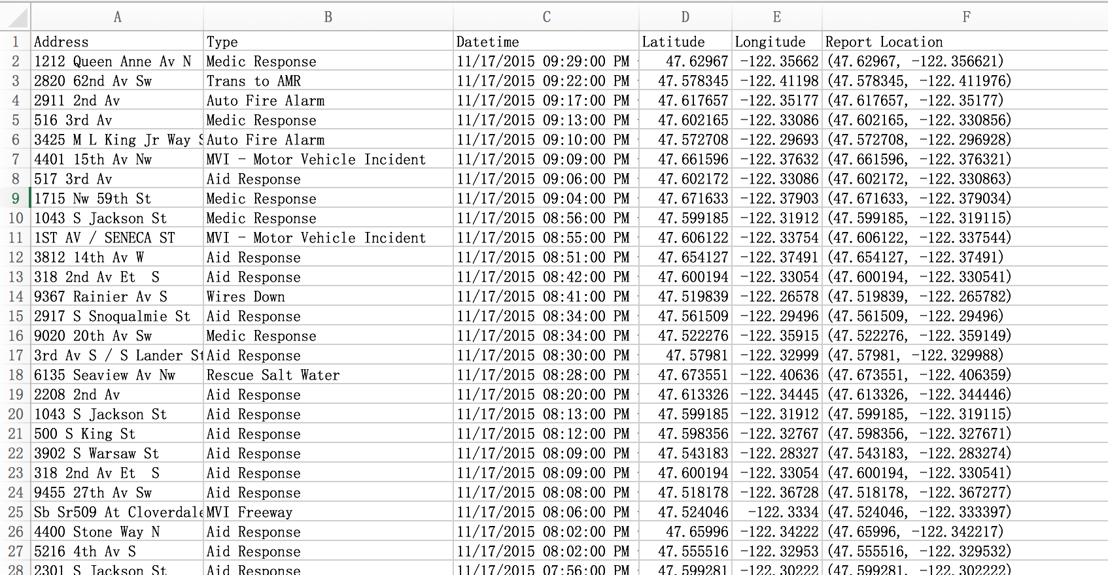
Datasets
Seattle Real Time Fire 911 calls
Seattle Map
Seattle Population Density

Slide 5
Data Processing
Data clean up: remove years 2010 and 2011
remove street location
remove incident number
More than 300 thousands (356754) of columns of data to process filed in csv
Seattle Map from US.json

Slide 6
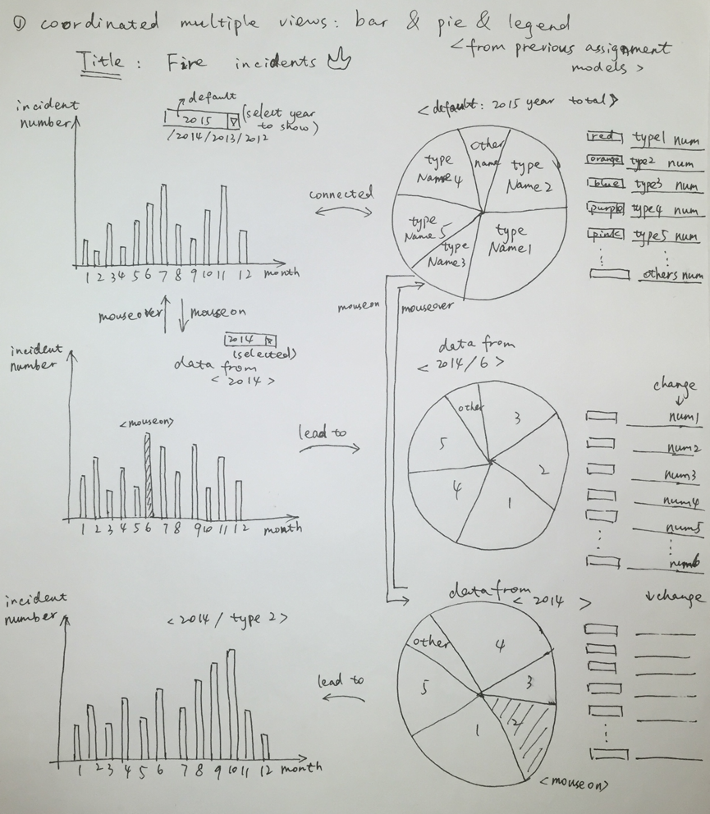
Prototype Design
Design 1: Coordinated multiple views:
bar chart, pie chart and legend.

Slide 7
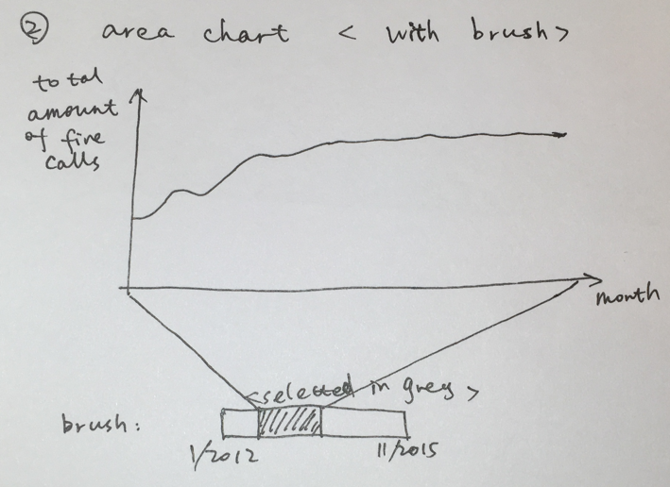
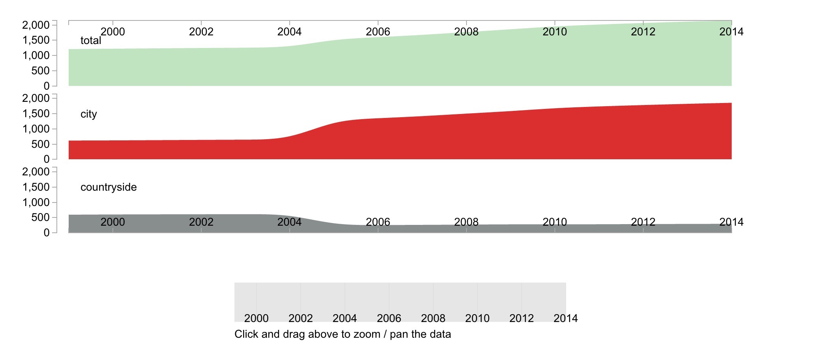
Prototype Design
Design 2: Area chart with brush shows time varying specific type.

Slide 8
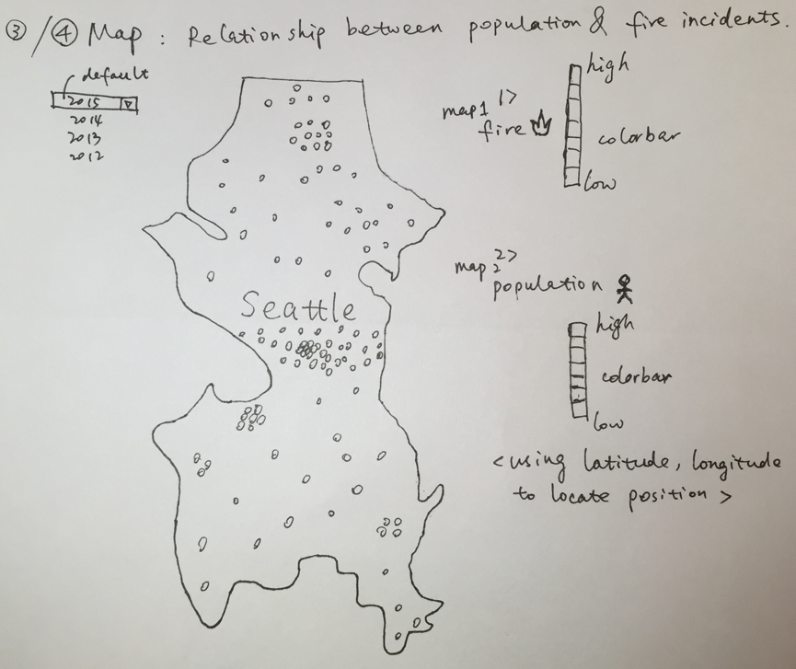
Prototype Design
Design 3: Points Maps
1> Population density
2> Fire incident density

Slide 9
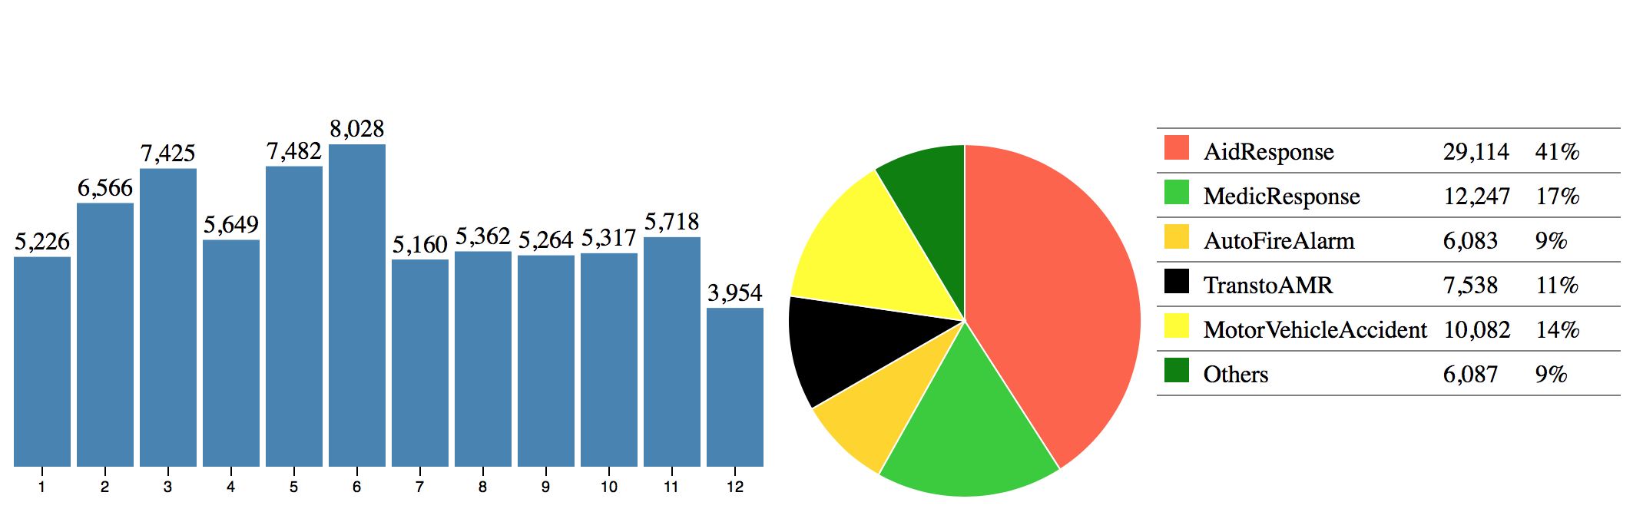
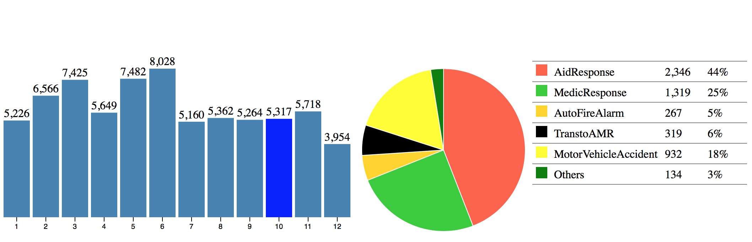
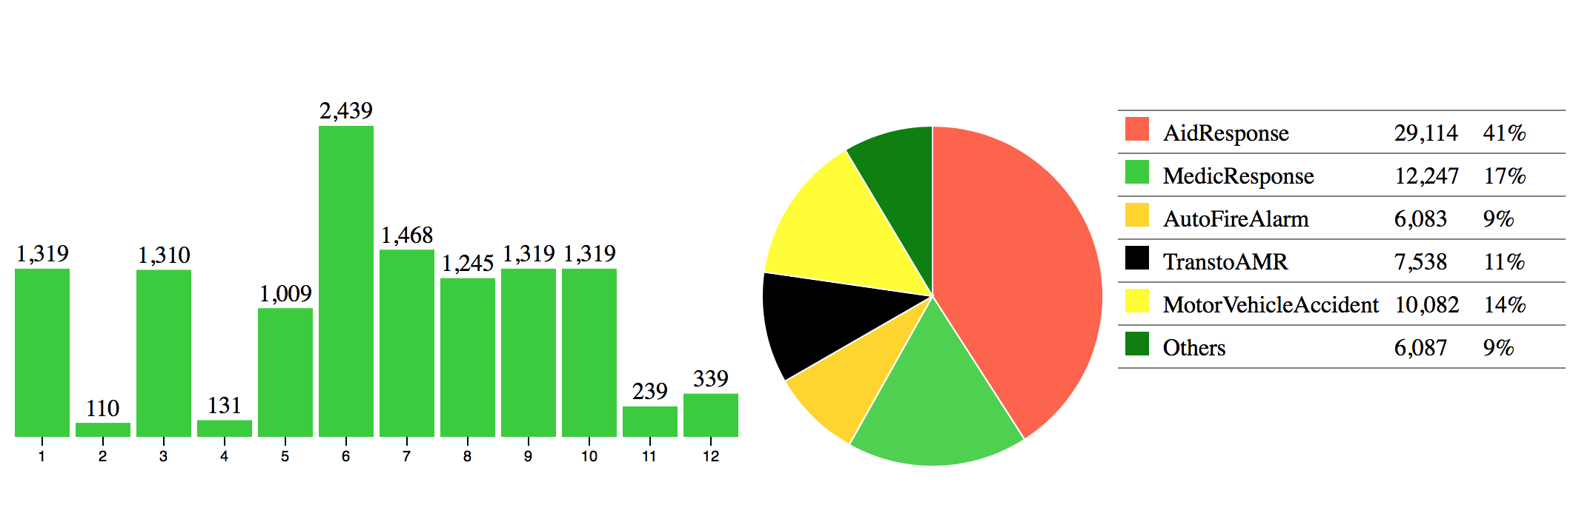
Coordinated multiple views: bar chart, pie chart and legend

Slide 10
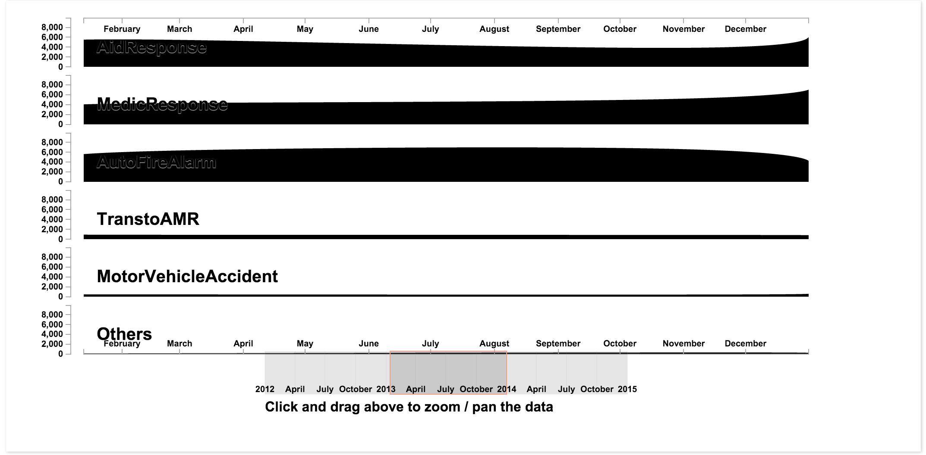
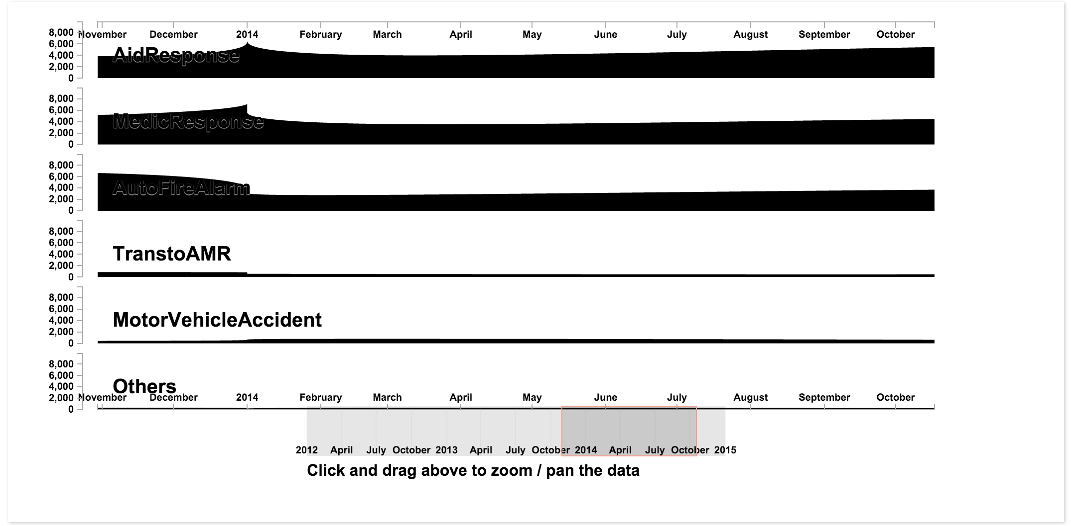
Area chart with brush shows time varying specific type

Slide 11
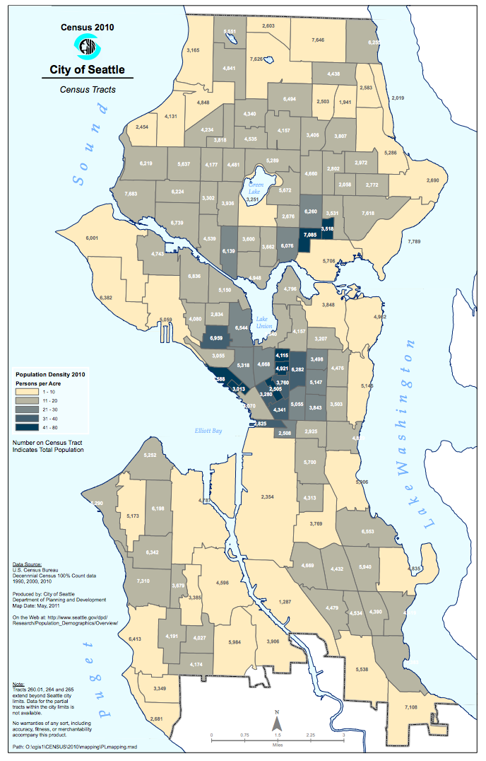
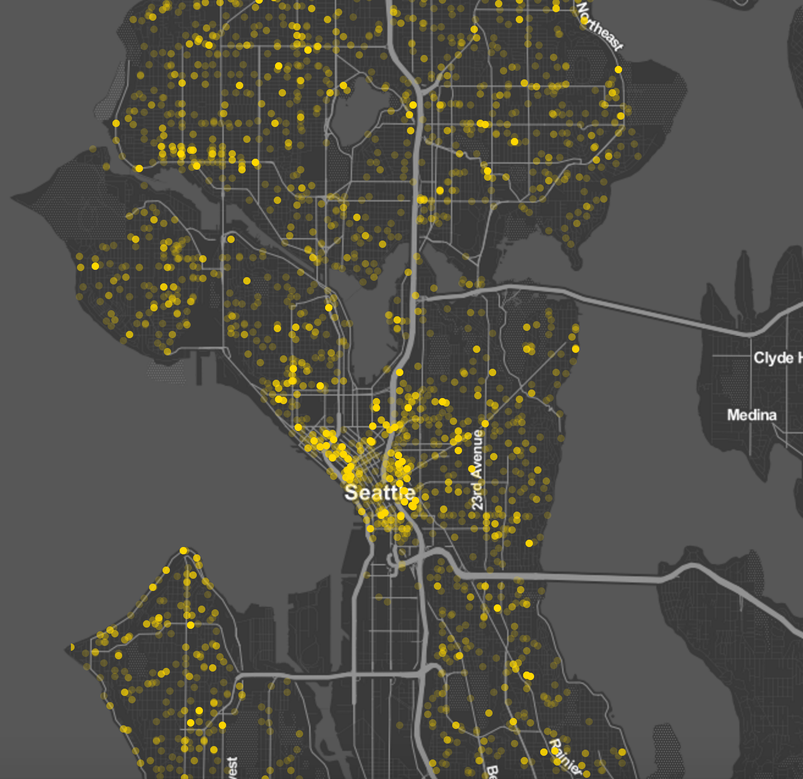
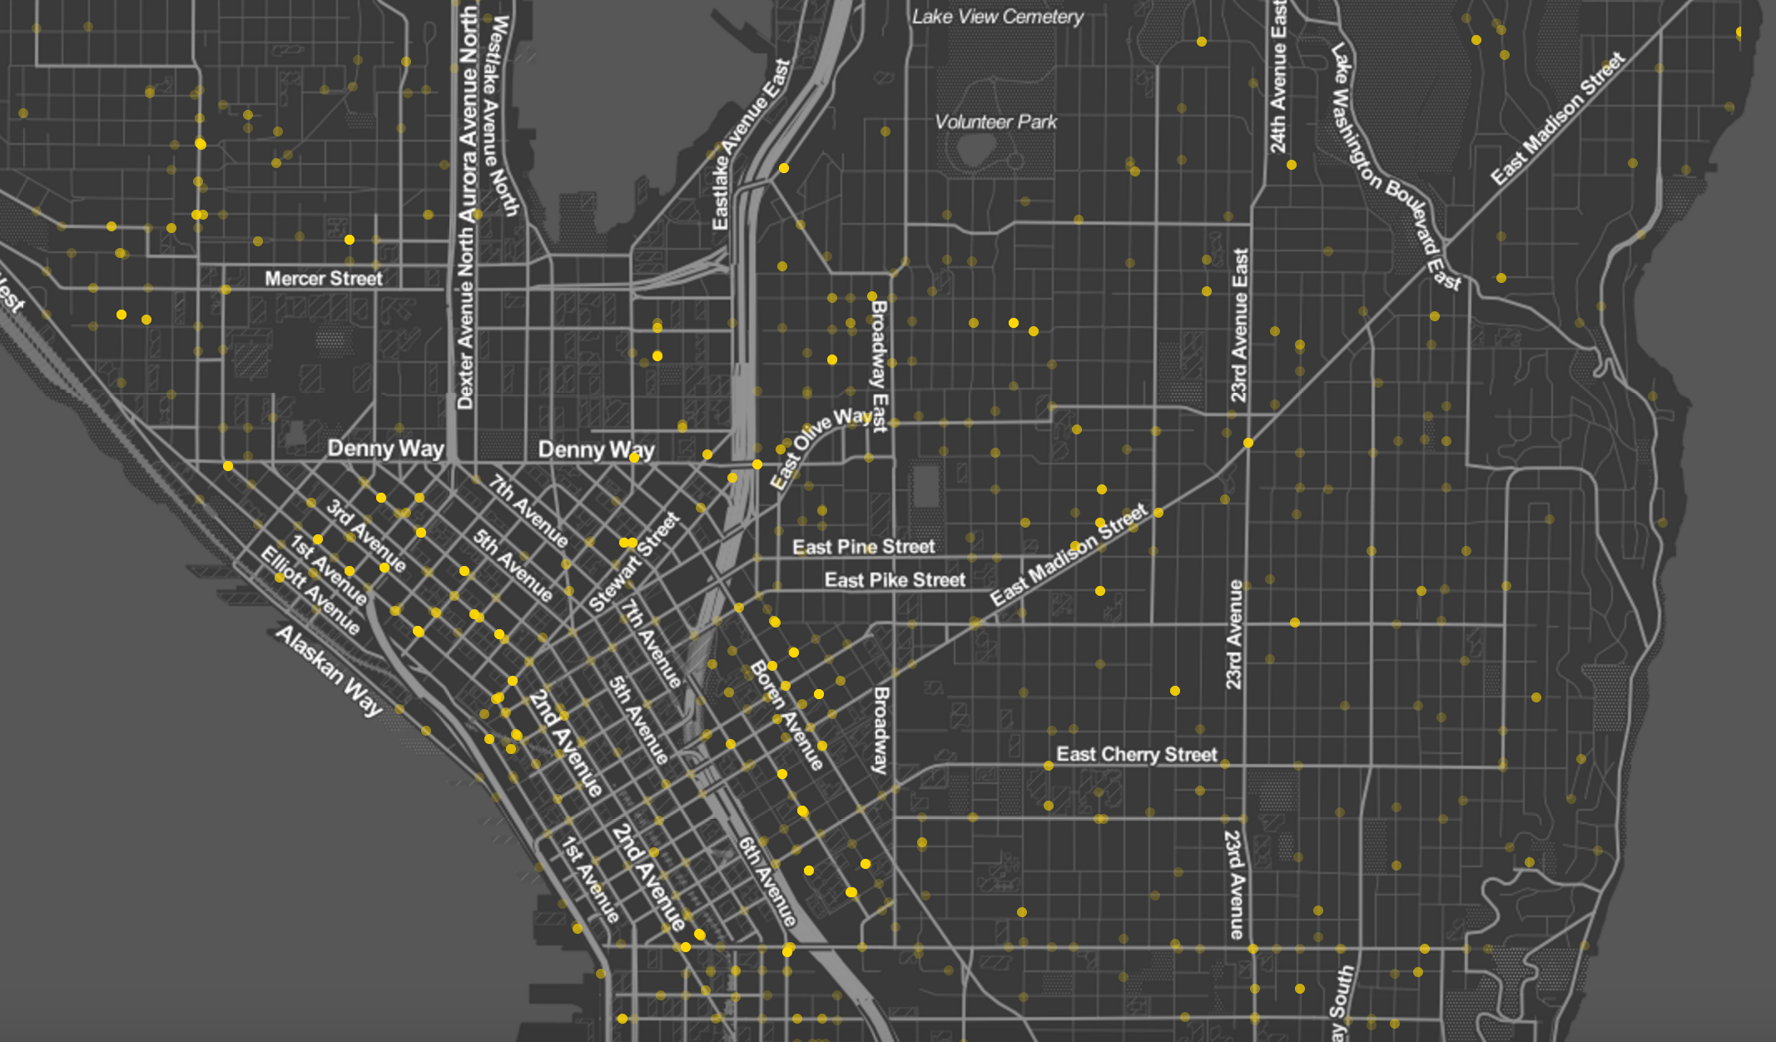
Points Maps -- Fire incident density

Slide 12
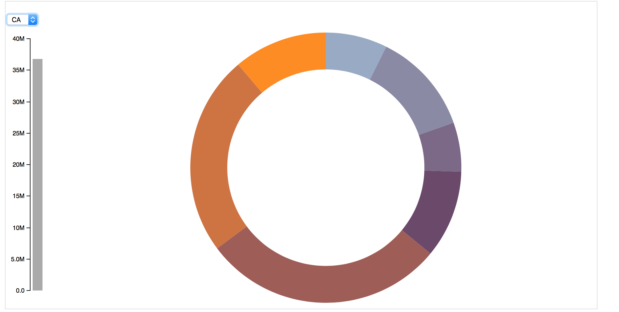
Work needs to be done later
For bar chart, add a selection button, an example is here.
Change the color of area chart.
Population density map for Seattle.
Aggregate the four parts together and
design the website in a better order.

Slide 13
Thank you!

